Slide 1


Unlock Your Financial Future: Passive Income Through Stock Marketing!
Are you looking for ways to grow your income, secure your family's future, or earn extra money while studying? Our project is designed to demystify passive income and stock market investing, turning confusion into confidence.

Slide 2


The Passive Income Challenge
Many of us rely on a single source of income, leading to anxiety about future financial stability. The desire to earn more for family welfare or gain side income as a student is strong, but the path to achieving it often feels complex and risky.
Middle-Aged Professionals
Seeking reliable secondary income for family security and long-term goals.
Students and Young Adults
Needing flexible side income to manage expenses and start building wealth early.

Slide 3





The Investment Dilemma: Fear and Uncertainty
“I want to invest, but I don't know where to start. It feels too complicated.”
“How do I choose the right stocks? I'm afraid of losing my hard-earned money.”
“I don't have time to research markets. Is there a simple way to get insights?”
The biggest hurdle isn't the market—it's the fear of the unknown. Our solution is built to remove that uncertainty and provide clear, actionable guidance.

Slide 4

Introducing Our Solution: Confidence in Investment
We have created an intuitive website designed to cut through the complexity of investing. Our goal is to empower non-expert users with clarity, trust, and simplicity.
1
2
3
Simplicity First
Data-Driven Insights
Actionable Guidance
A clean, easy-to-navigate interface that welcomes beginners.
We use reliable data and factors to generate personalized investment information.
We tell you if you should invest, how much you could profit, and why.

Slide 5
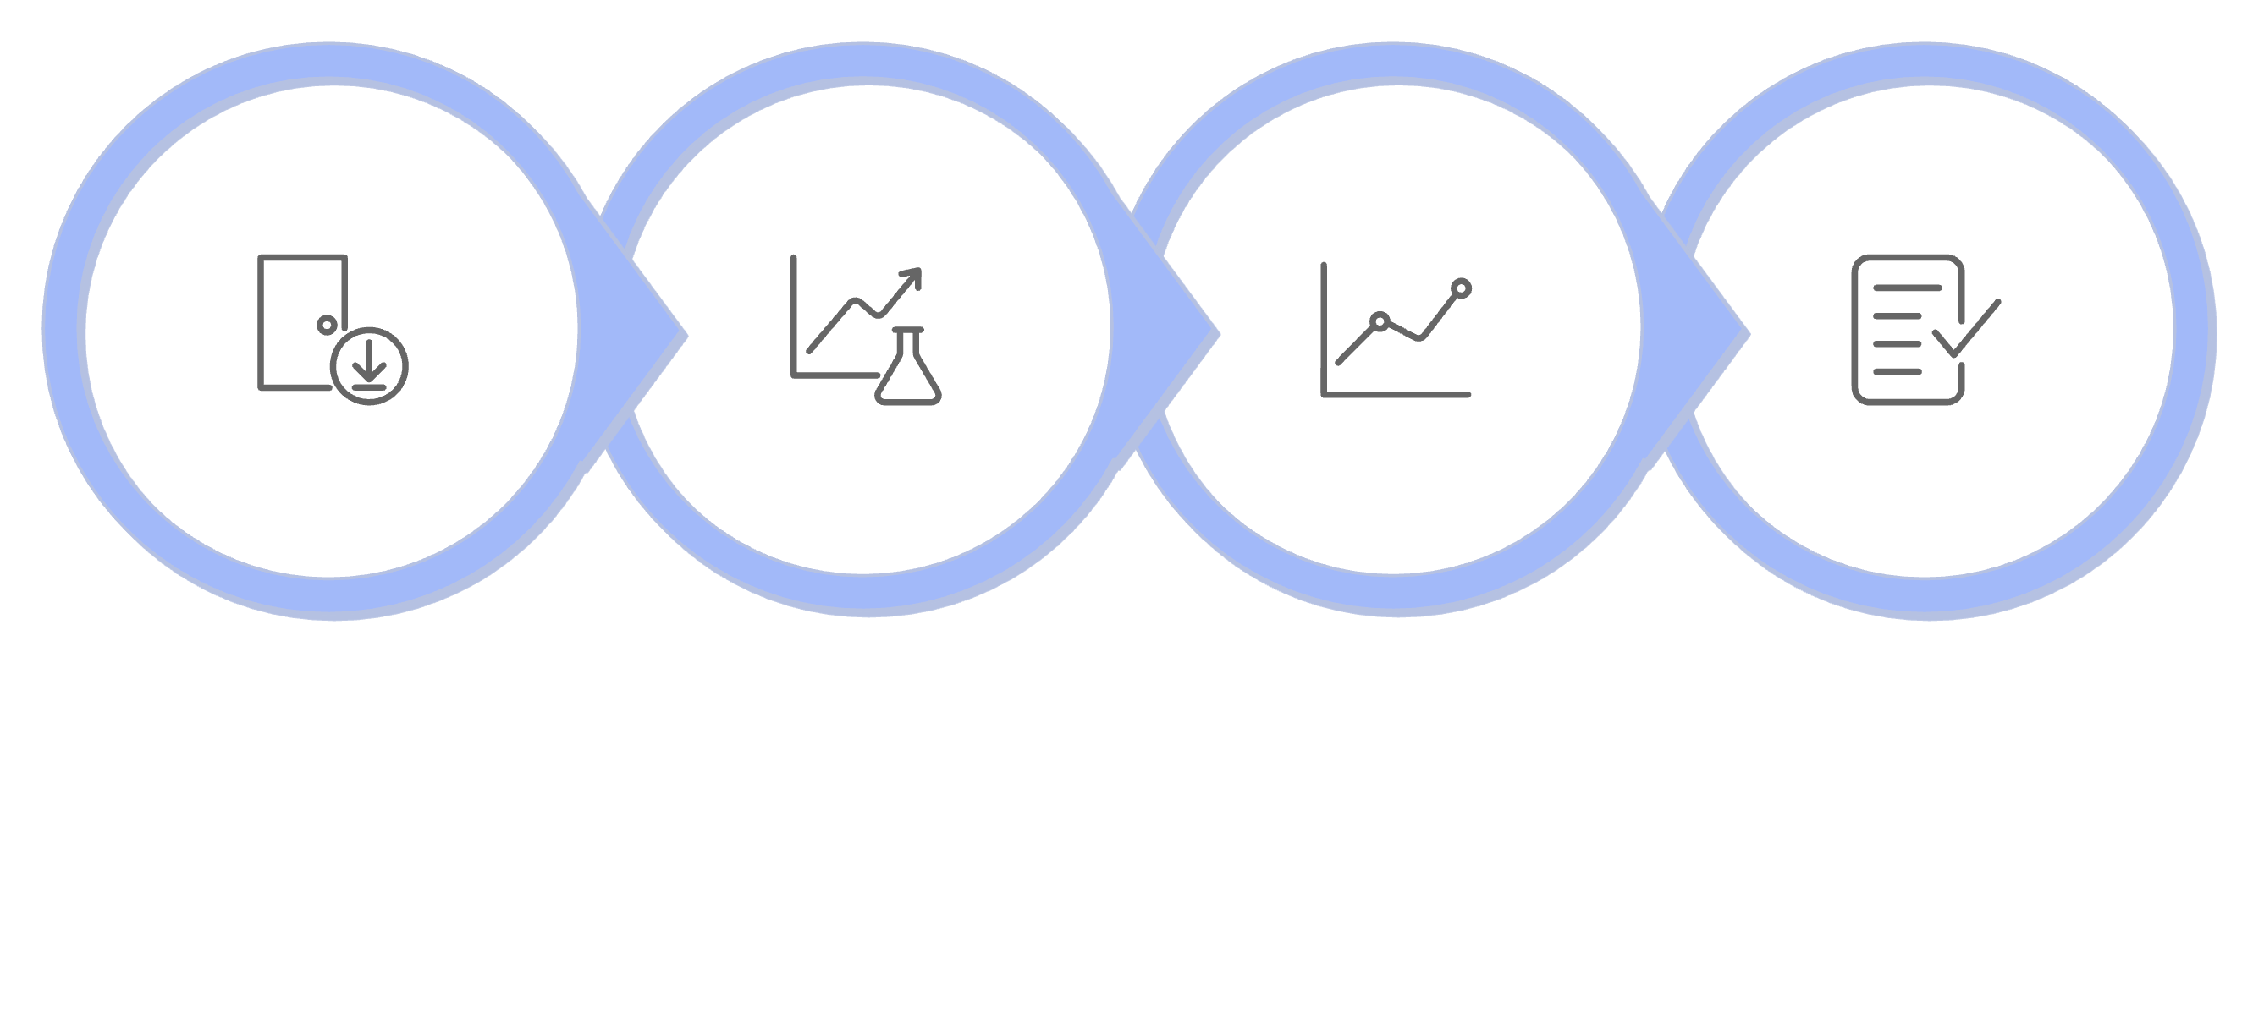





How It Works: Your Personalized Investment Plan
Enter Amount & Time
Process & Analyze
Forecast & Recommend
Decide & Invest
Getting started is simple. Just tell us two things to unlock personalized, data-backed insights.

Slide 6




Input: Tell Us Your Goals
Amount to be Invested
Investment Time Frame
This is the capital you are willing to dedicate to your passive income journey.
The duration over which you plan to hold your investment, crucial for growth projections.
Our system takes these inputs and instantly begins processing them against real-time
market data and historical performance indicators.

Slide 7

Output: Clear, Detailed Insights
The website provides all the essential information you need before making an investment commitment, ensuring you are never guessing.
Profit Forecasts
Clear estimations of potential returns based on your input and market factors.
Investment Recommendation
A simple 'Yes' or 'No' on whether the investment aligns with your goals and risk profile.
Benefit Analysis
A detailed breakdown of how you will be financially better off.
Full Disclosure
Comprehensive details, including the pros and cons of the suggested strategy.

Slide 8




Transparency and Trust: Pros and Cons
We believe in full transparency. Every recommendation comes with an unbiased analysis of the potential advantages and disadvantages, allowing you to weigh your options with confidence.
The Pros: Why Invest?
The Cons: Potential Risks
Potential for significant passive income growth.
Market volatility means returns are not guaranteed.
Diversification of your current income streams.
Risk of loss of capital in unfavorable market conditions.
Ease of investment with low management time required.
Need for initial capital outlay to begin investing.
Long-term wealth accumulation for family welfare or retirement.
Inflation and economic shifts can impact real returns.

Slide 9






Building Financial Confidence, Together
Maximize Profits
Identify opportunities with high potential for passive returns.
Minimize Fear
Invest with confidence, backed by clear data and detailed risk analysis.
Empower Learning
Gain the financial literacy needed to make informed decisions.
Save Time
Receive quick, digestible insights without extensive market research.

Slide 10


Ready to Start Your Passive Income Journey?
Invest Simply, Live Fully.
Our project is the tool you need to transform anxiety into a strategic plan. Take control of your financial narrative today.
Learn more
Learn more

